Slide 1
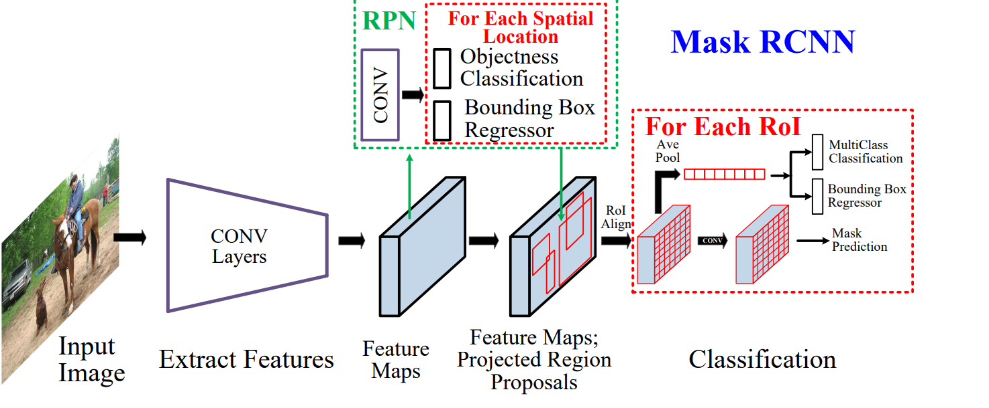
Detection: Two-stage (proposal-based)
Generate boxes proposals (with separate algorithm / net)
Warp them to one shape
Regress and classify them (with another algorithm)
Post-process predictions
https://arxiv.org/abs/1905.05055

Slide 2
Summary
Core ideas
Two-stage detectors

Slide 4
One-stage detectors
SSD, YOLO

Slide 5
Detection: Taxonomy
Detectors
Two-Stage (Proposal-based)
RCNN
Fast RCNN
Faster RCNN
Mask RCNN
One-Stage
SSD
YOLOv3
DSOD
RFBNet
Points-based
CenterNet
CornerNet
ExtremeNet
EfficientDet (NAS)
Time

Slide 6
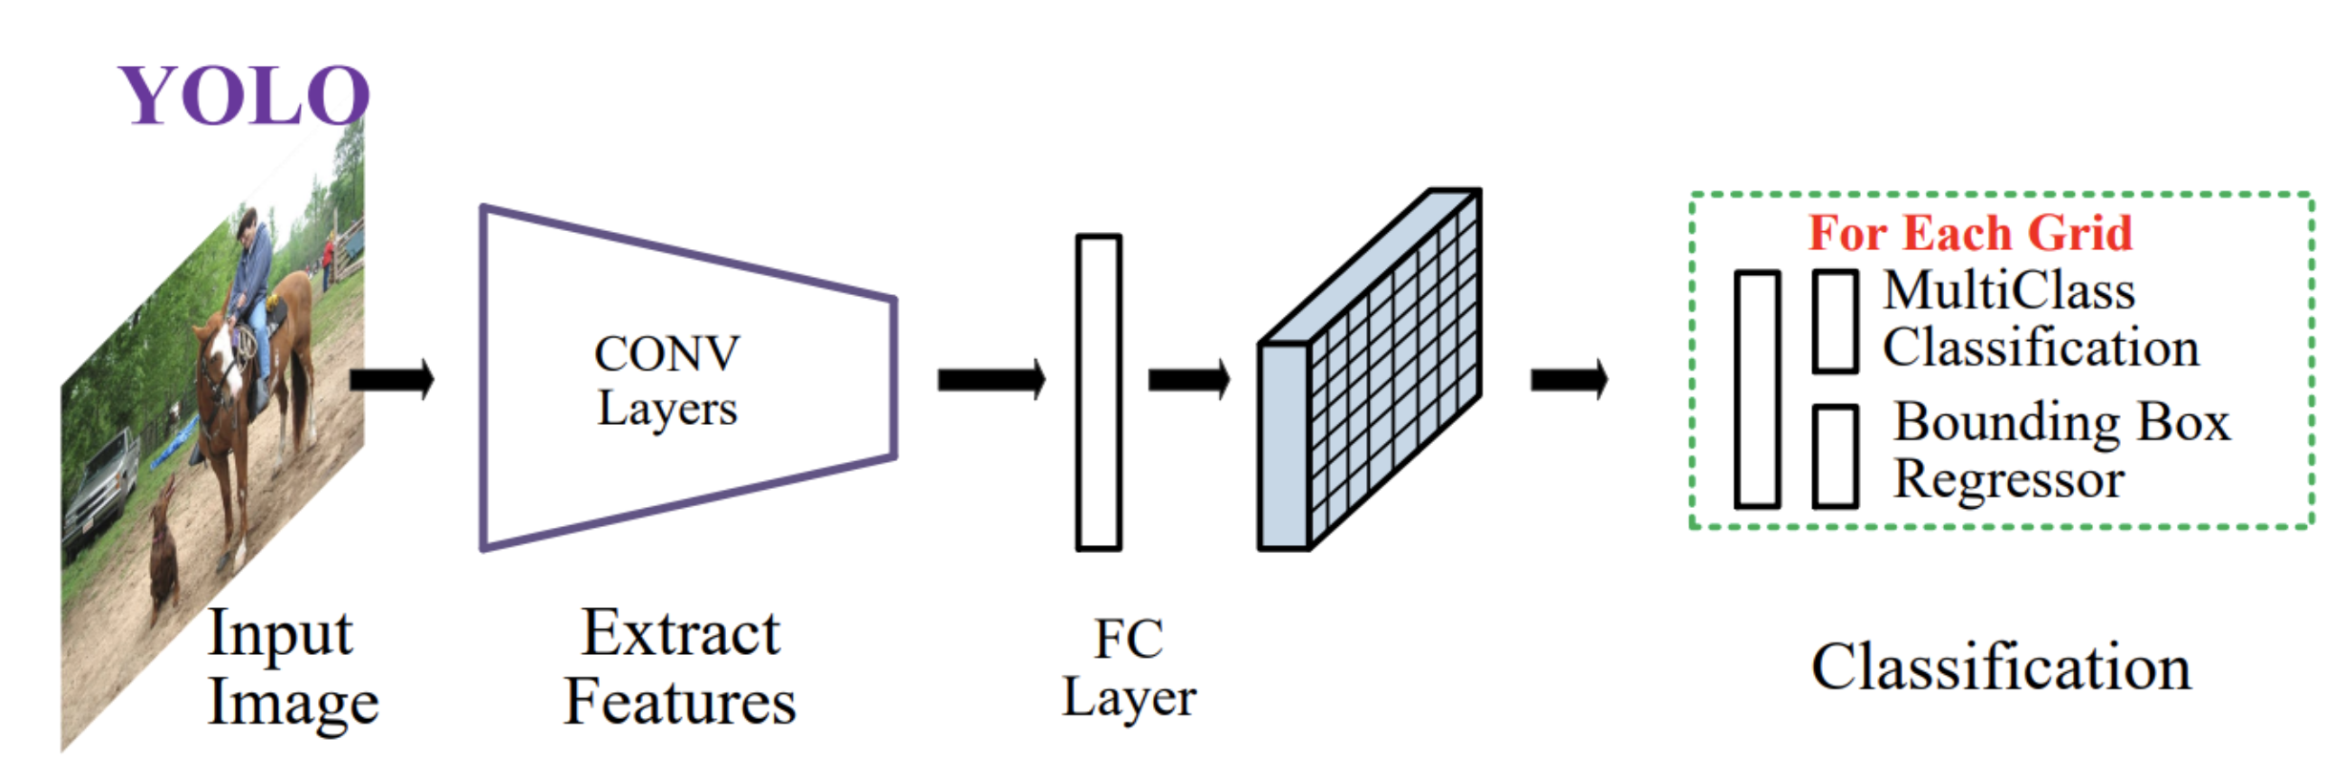
Detection: You Only Look Once
Get features from a Backbone Network
Predict feature map (“grid”)
Predict boxes from grid
Post-process predictions
https://arxiv.org/abs/1905.05055

Slide 7
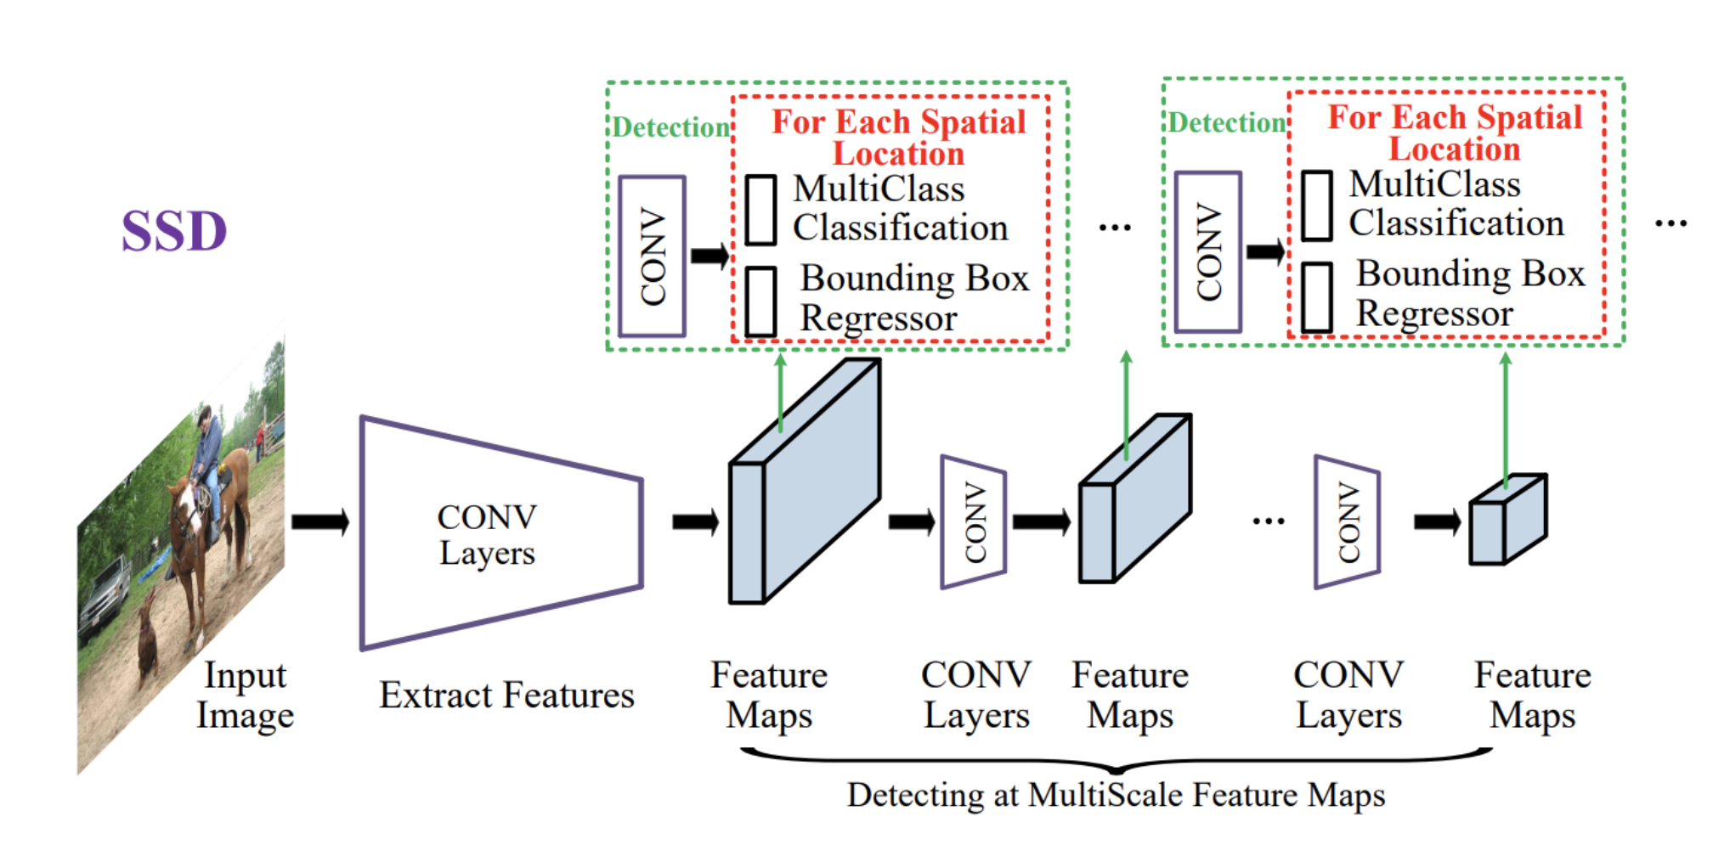
Detection: Single-Shot Multibox Detector (SSD)
Get features from a Backbone Network
Predict feature map (“grid”)
Predict boxes from grid
Post-process predictions
https://arxiv.org/abs/1905.05055

Slide 8
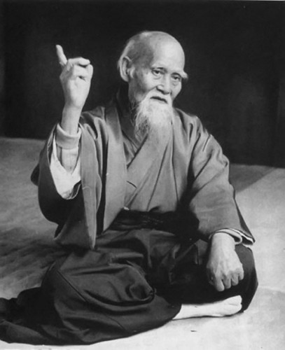
“Hone one thing,
but to the ideal”
Some clever person

Slide 9
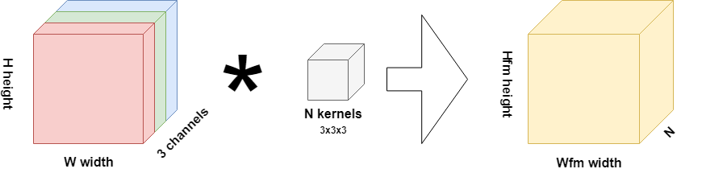
Convolutions: recap
cell
image
conv kernels (filters)
feature map
Notes:
Image, Conv, Pool, Shortcut, Feature map, conv6_4, Feature map Cell, Receptive field

Slide 10
Convolutions: recap
cell
image
conv kernels (filters)
feature map
Notes:
Image, Conv, Pool, Shortcut, Feature map, conv6_4, Feature map Cell, Receptive field

Slide 11
Convolutions: recap
image
conv kernels (filters)
feature map
Notes:
Image, Conv, Pool, Shortcut, Feature map, conv6_4, Feature map Cell, Receptive field

Slide 12
Convolutions: recap
cell
image
conv kernels (filters)
feature map
Notes:
Image, Conv, Pool, Shortcut, Feature map, conv6_4, Feature map Cell, Receptive field

Slide 13
SSD: up-to-bottom explanation
SSD pipeline
Input: image (h,w,3) → Backbone
Backbone → feature map
Feature map → boxes locations and classes inside of them
Detection task
How many boxes?
What should be the size of an input image?
How to train? (~ how to make it differentiable?)

Slide 14
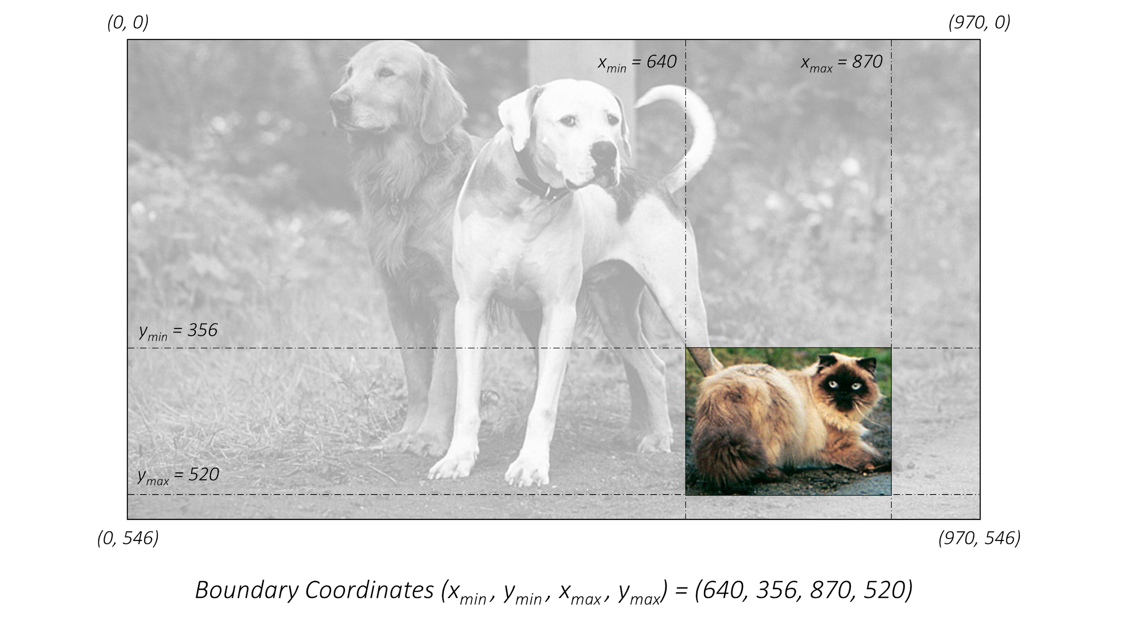
SSD: tlrb format
https://github.com/sgrvinod/a-PyTorch-Tutorial-to-Object-Detection

Slide 15
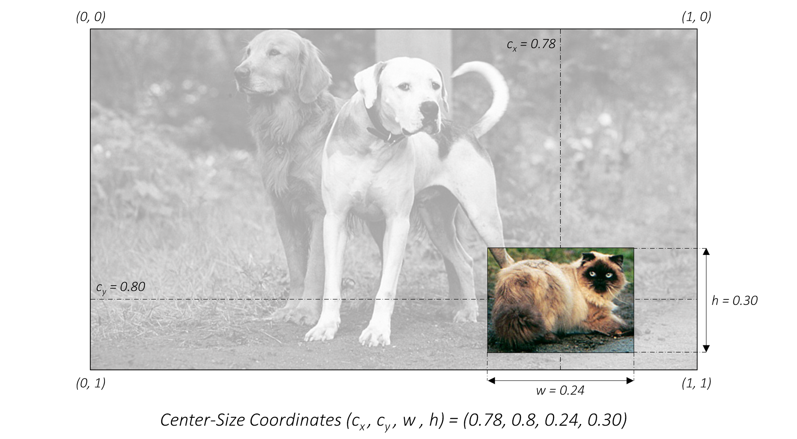
SSD: xywh format
https://github.com/sgrvinod/a-PyTorch-Tutorial-to-Object-Detection

Slide 16
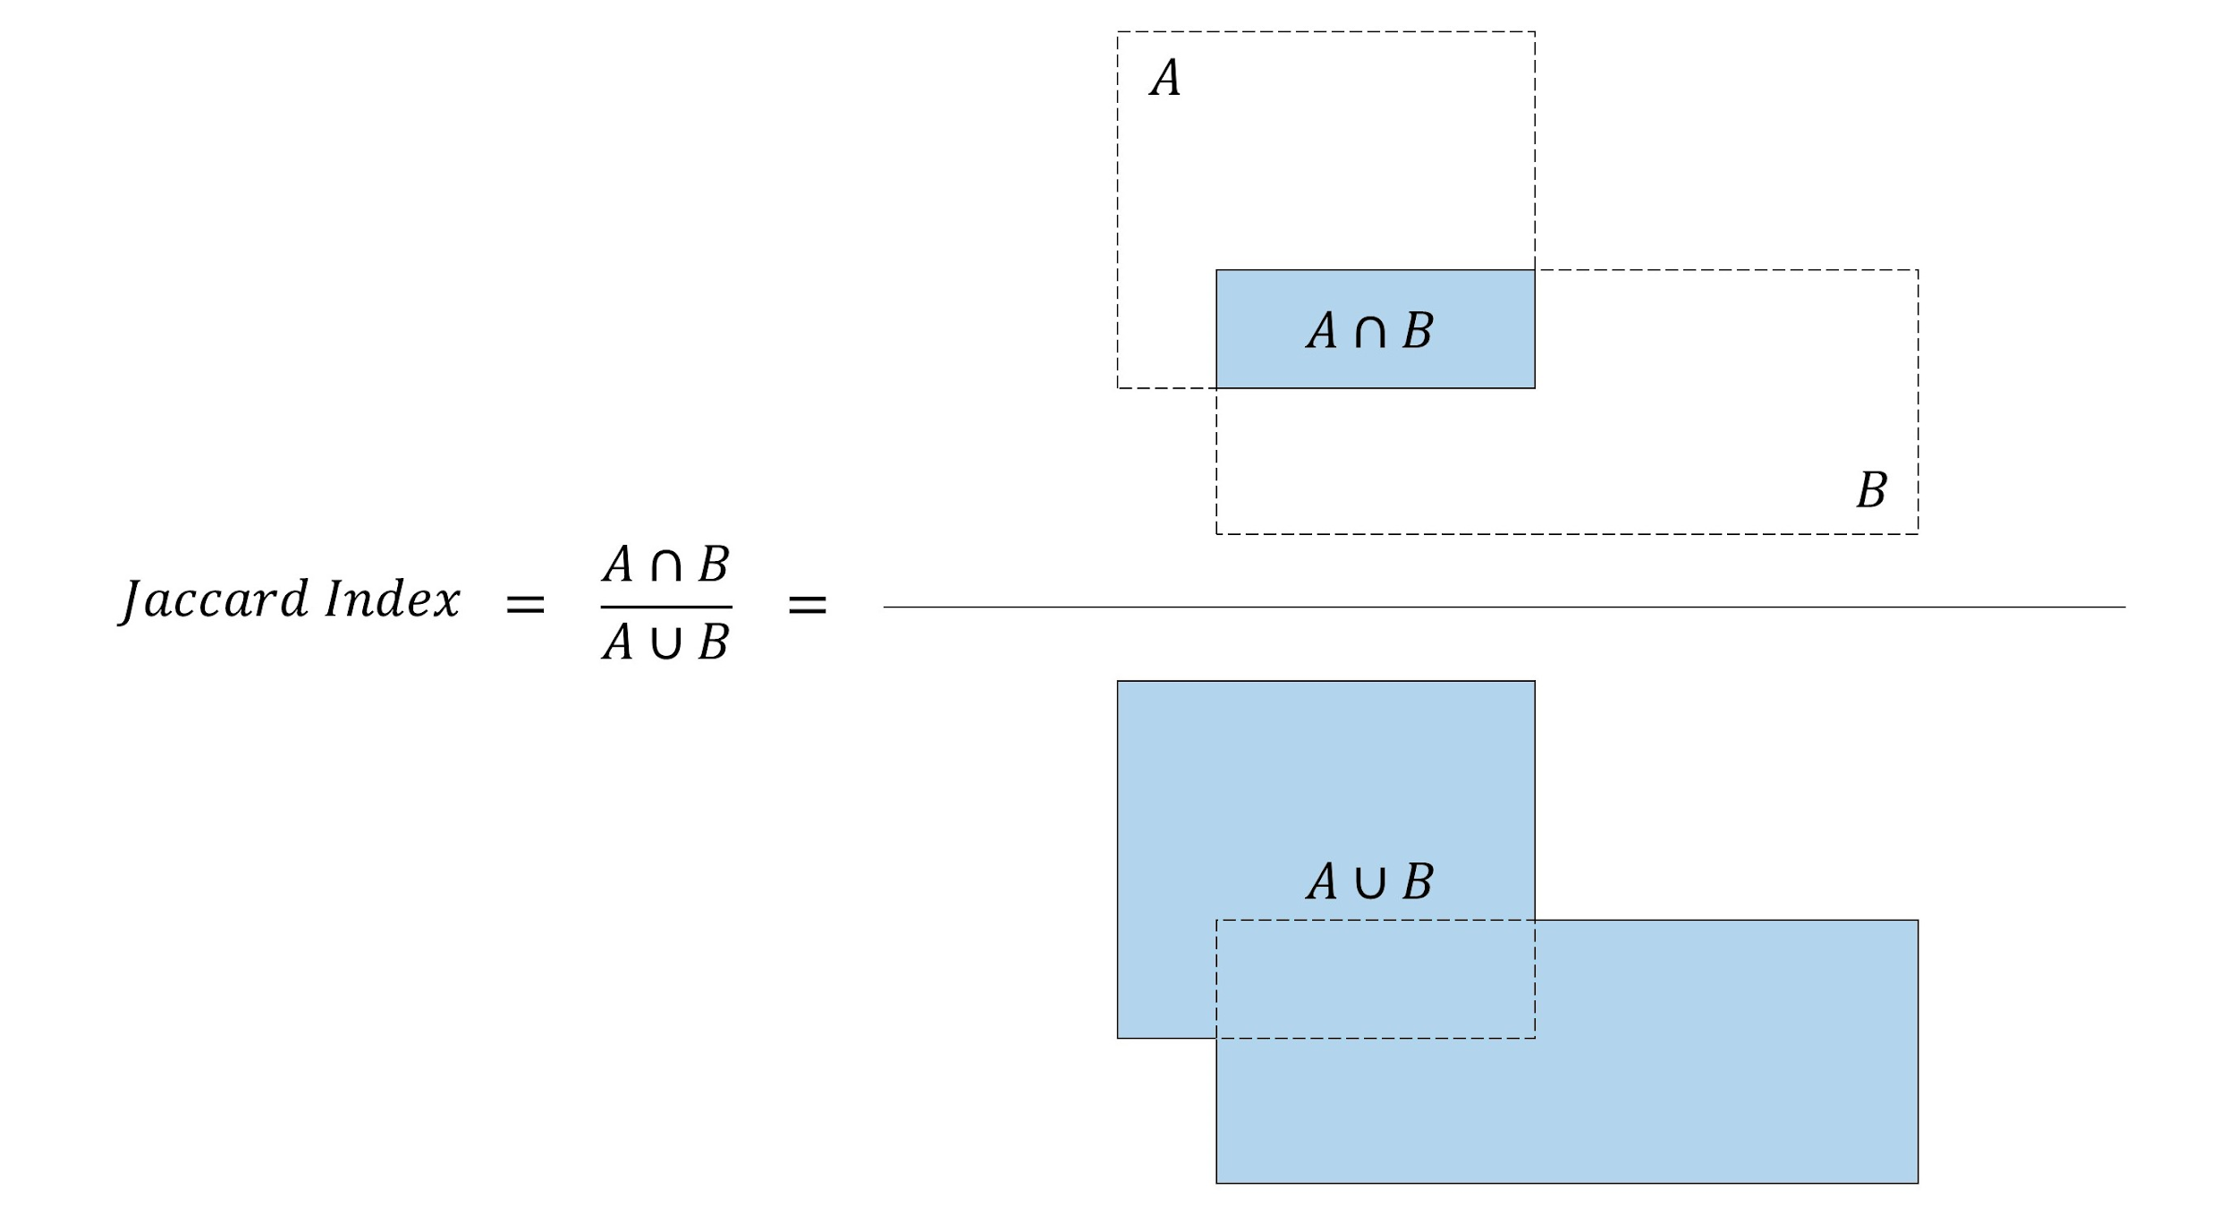
SSD: Intersection over Union
https://github.com/sgrvinod/a-PyTorch-Tutorial-to-Object-Detection

Slide 17
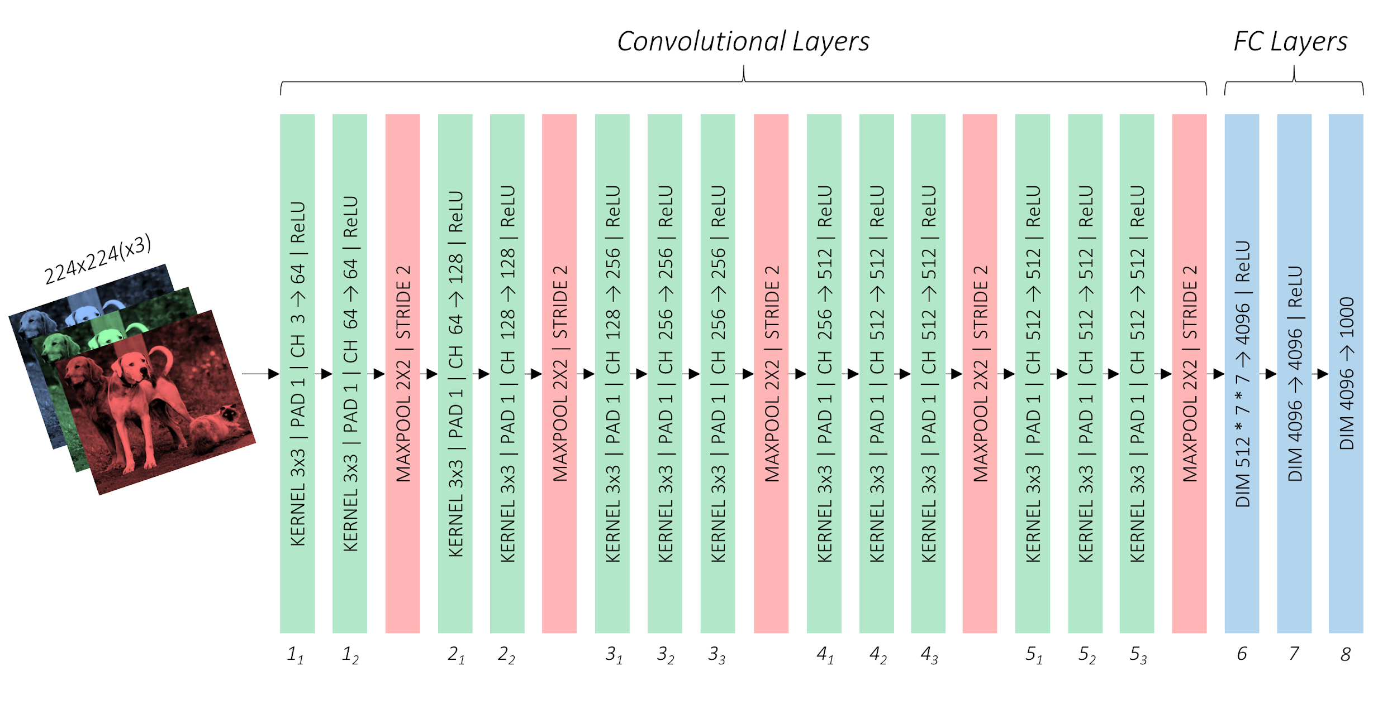
SSD: VGG
https://github.com/sgrvinod/a-PyTorch-Tutorial-to-Object-Detection

Slide 18
SSD: VGG
https://github.com/sgrvinod/a-PyTorch-Tutorial-to-Object-Detection

Slide 19
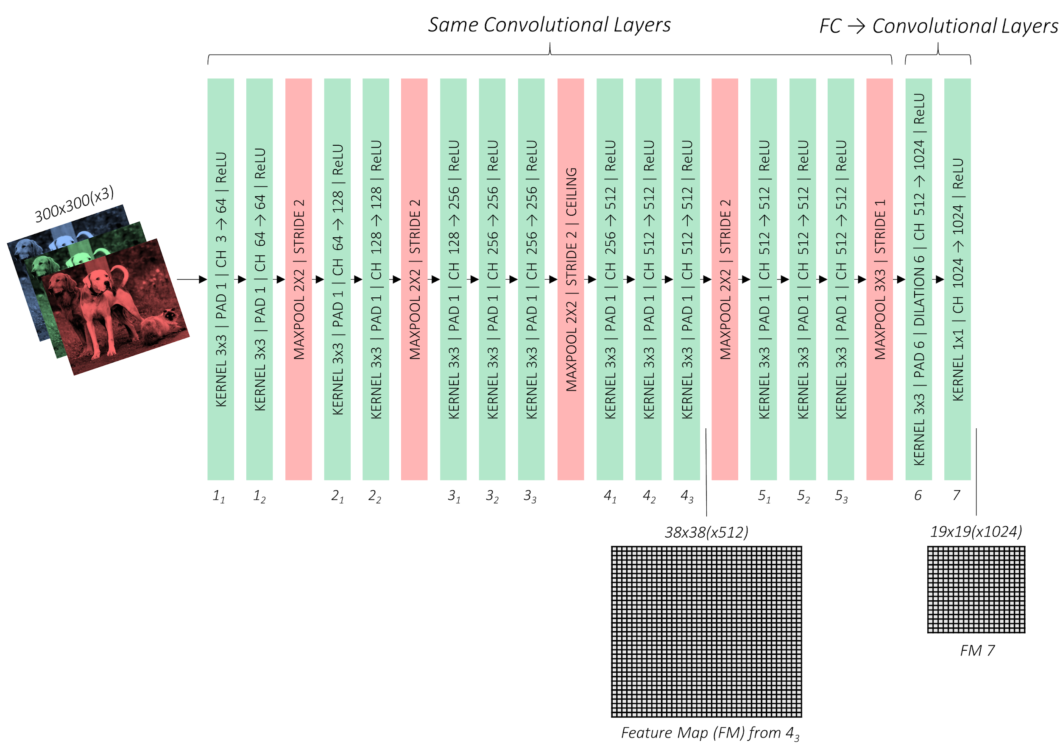
SSD
https://github.com/sgrvinod/a-PyTorch-Tutorial-to-Object-Detection

Slide 20
SSD: VGG
https://github.com/sgrvinod/a-PyTorch-Tutorial-to-Object-Detection

Slide 21
SSD: VGG
Auxiliary Layers
https://github.com/sgrvinod/a-PyTorch-Tutorial-to-Object-Detection

Slide 22
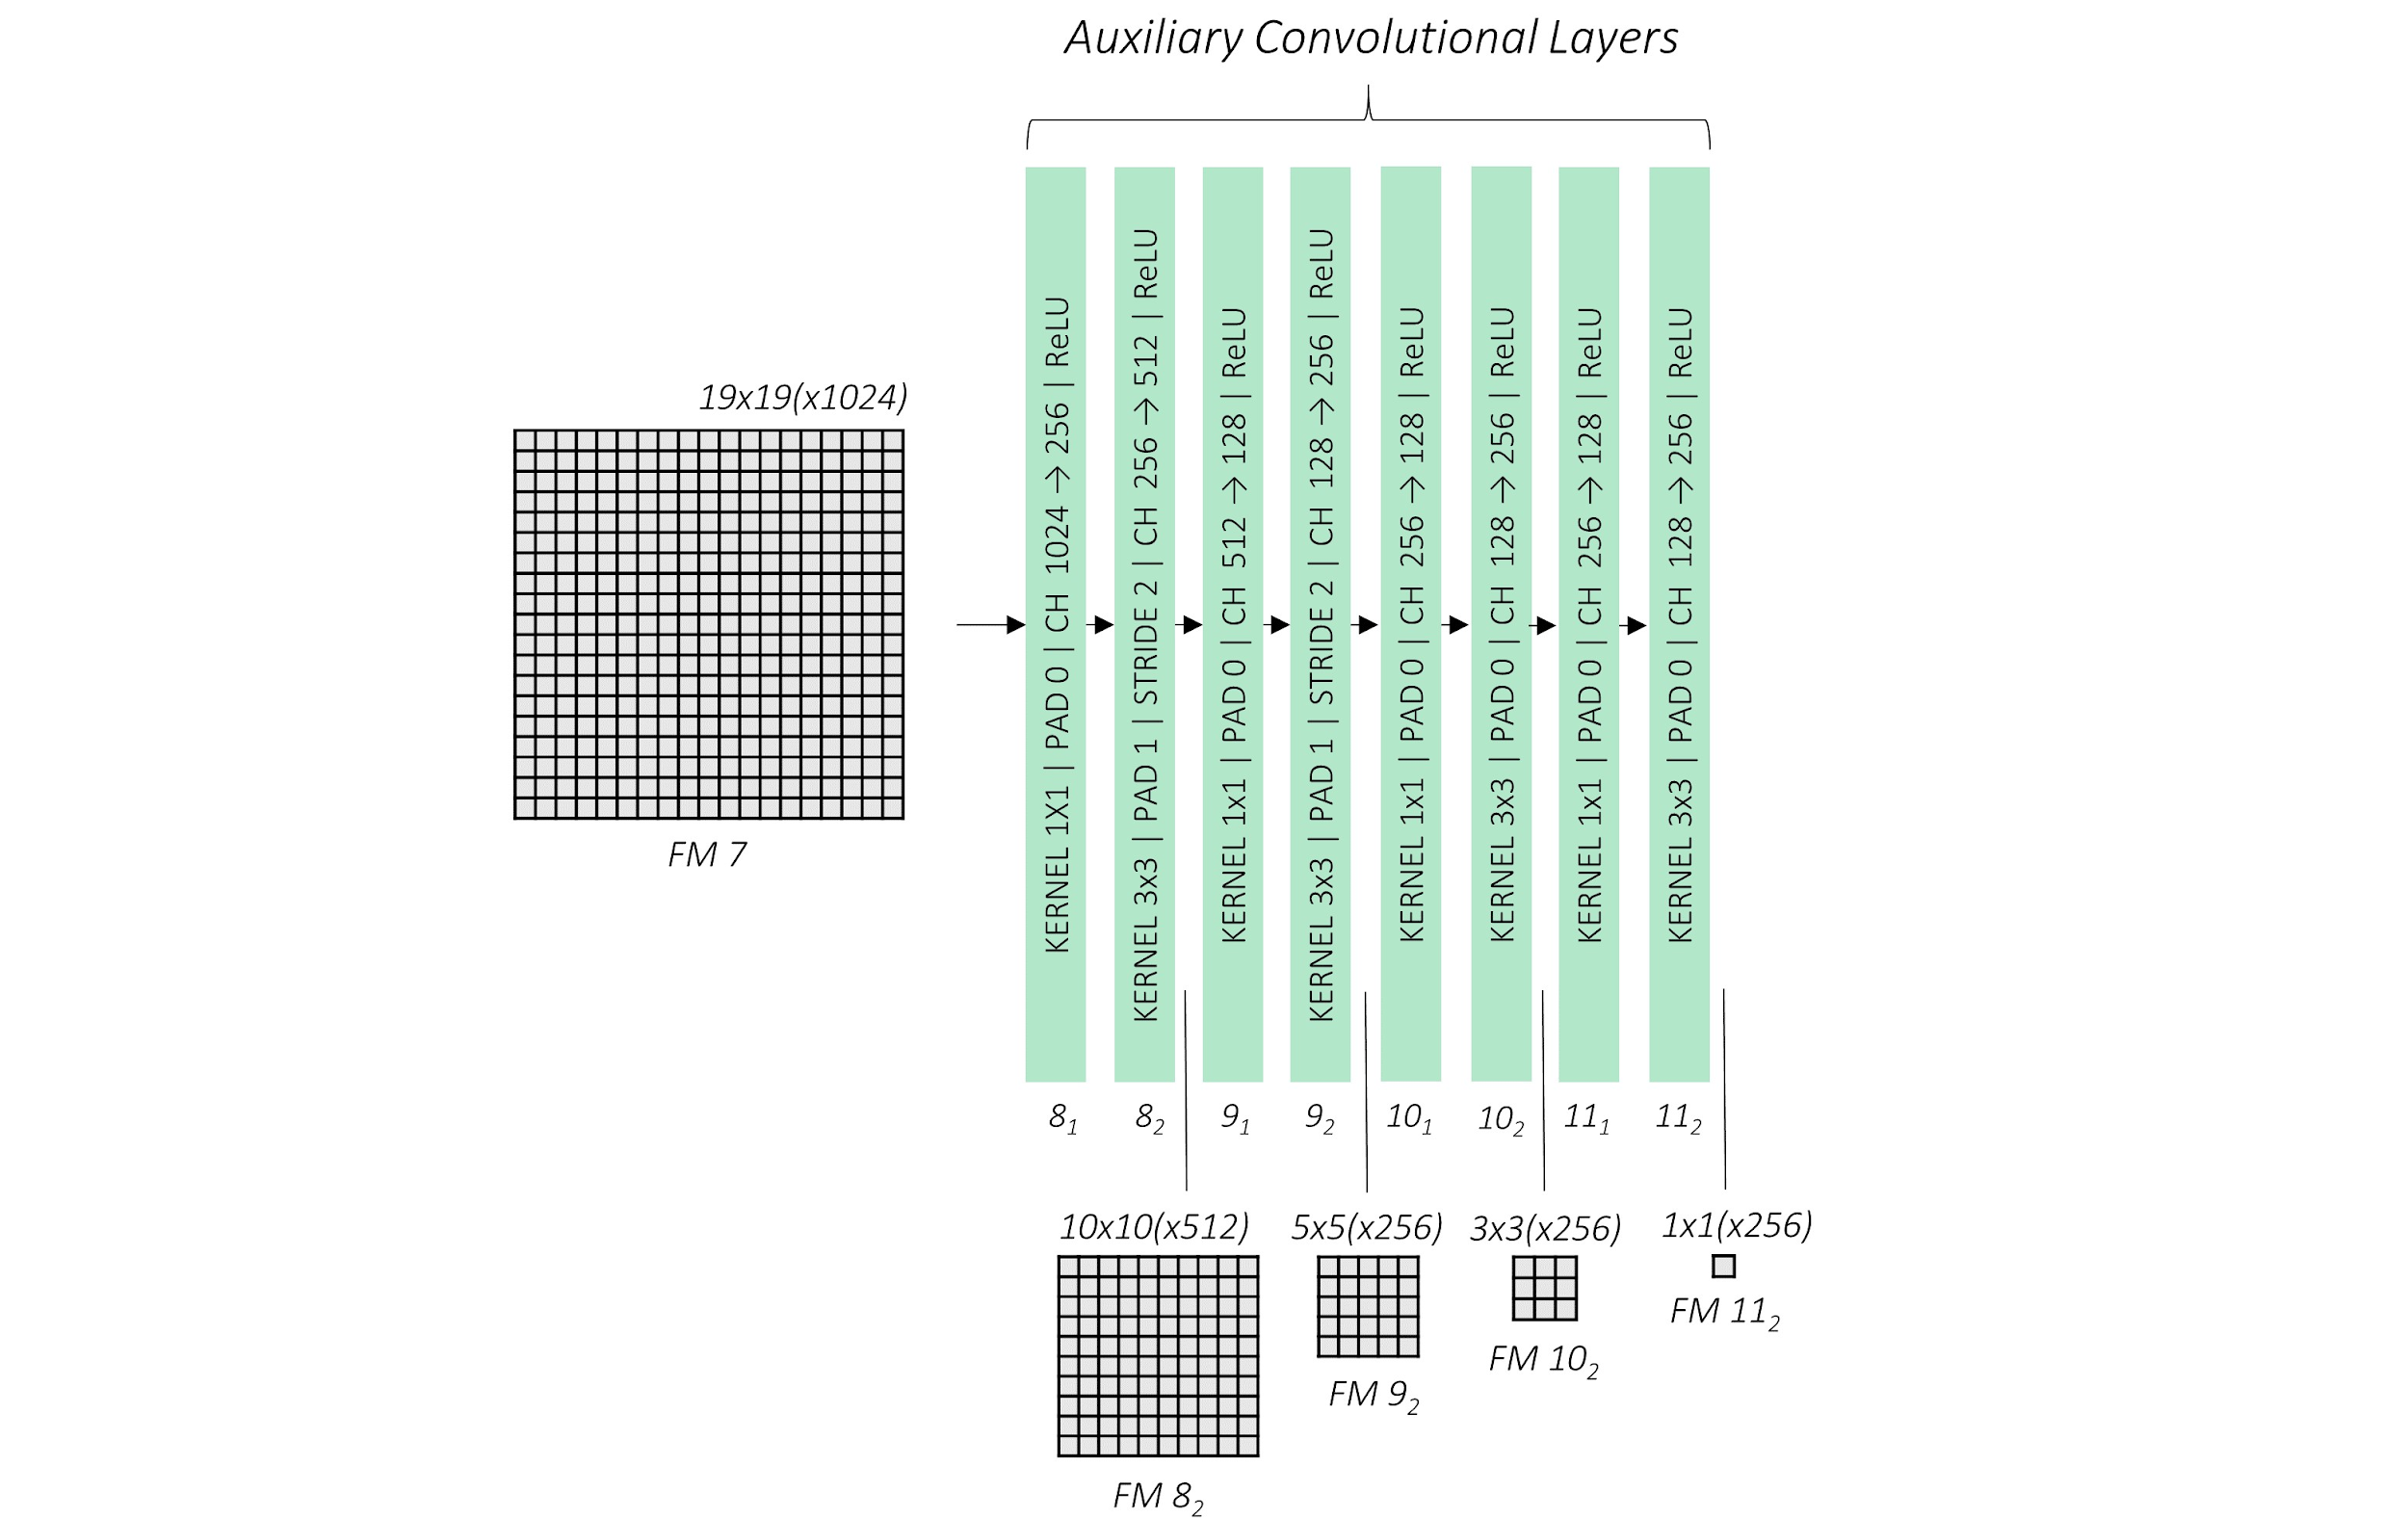
SSD: auxiliary (“extra”) layers
https://github.com/sgrvinod/a-PyTorch-Tutorial-to-Object-Detection

Slide 23
SSD: feature maps
https://github.com/sgrvinod/a-PyTorch-Tutorial-to-Object-Detection

Slide 24
SSD
Each of these feature maps’ cells has 4-6 “default boxes”
https://github.com/sgrvinod/a-PyTorch-Tutorial-to-Object-Detection

Slide 25
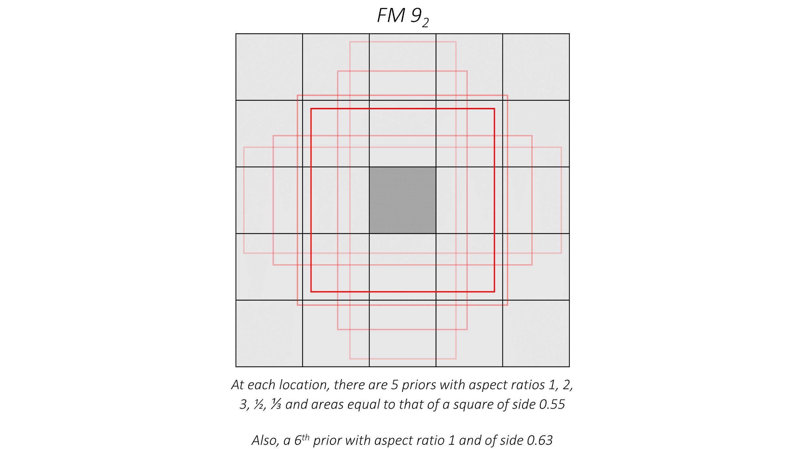
SSD: “default boxes” of one cell
Each of these feature maps’ cells has 4-6 “default boxes”
https://github.com/sgrvinod/a-PyTorch-Tutorial-to-Object-Detection

